Slide 1
18CSC202J - Object Oriented Design and Programming
18CSC202J - Object Oriented Design and Programming S - 1 / UNIT - 3

Slide 2
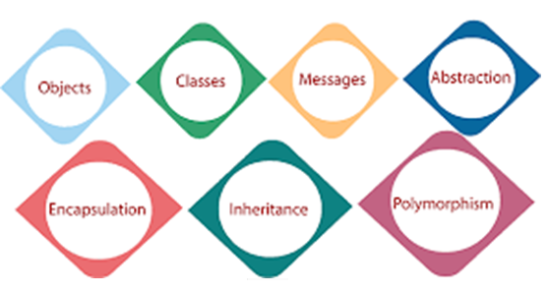
UNIT – III
18CSC202J - Object Oriented Design and Programming S - 1 / UNIT - 3

Slide 3
SLO-1 & SLO-2 : FEATURE INHERITANCE : SINGLE & MULTIPLE, MULTILEVEL AND EXAMPLE
18CSC202J - Object Oriented Design and Programming S - 1 & 3 / UNIT - 3

Slide 4
Five different types of Inheritance
Single Inheritance
Multiple Inheritance
Hierarchical Inheritance
Multilevel Inheritance
Hybrid Inheritance (also known as Virtual Inheritance)
18CSC202J - Object Oriented Design and Programming S - 1 & 3 / UNIT - 3

Slide 5
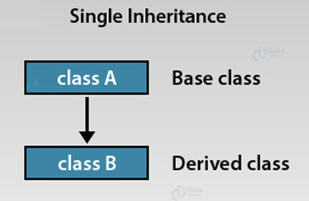
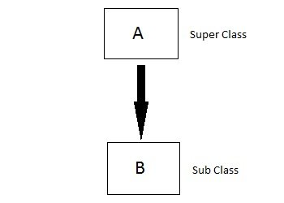
Single Inheritance
In this type of inheritance one derived class inherits from only one base class. It is the most simplest form of Inheritance.
This type of inheritance in C++ happens when the parent class has only one child class. In other words, this is only one derived class formed from a base class.
18CSC202J - Object Oriented Design and Programming S - 1 & 3 / UNIT - 3

Slide 6
Single Inheritance
Syntax-
class Base { // BODY OF THE BASE CLASS };
class Derived : acess_specifier Base { // BODY OF THE DERIVED CLASS };
18CSC202J - Object Oriented Design and Programming S - 1 & 3 / UNIT - 3

Slide 7
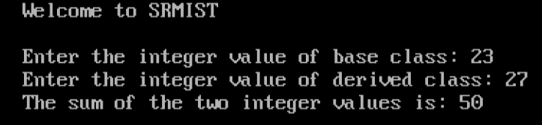
Single Inheritance
single1.cpp
#include <iostream.h>
#include<conio.h>
//using namespace std;
class Base
{
public:
int base_value;
void base_input()
{
cout<<"Enter the integer value of base class: ";
cin>>base_value;
}
};
class Derived : public Base
{
// private by default
int derived_value;
public:
void derived_input()
{
cout<<"Enter the integer value of derived class: ";
cin>>derived_value;
}
void sum()
{
cout << "The sum of the two integer values is: " << base_value + derived_value<<endl;
}
};
int main()
{
clrscr();
cout<<"Welcome to SRMIST"<<endl<<endl;
Derived d; // Object of the derived class
d.base_input();
d.derived_input();
d.sum();
return 0;
}
18CSC202J - Object Oriented Design and Programming S - 1 & 3 / UNIT - 3

Slide 8
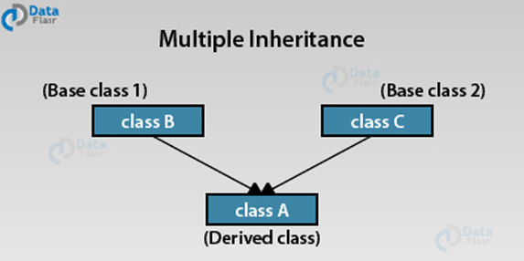
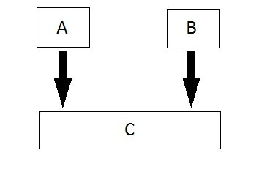
Multiple Inheritance
This type of inheritance happens when the child class inherits its properties from more than one base class. In other others, the derived class inherits properties from multiple base classes.
a class can be derived from more than one parent.
For example, A class Bat is derived from base classes Mammal and WingedAnimal. It makes sense because bat is a mammal as well as a winged animal.
18CSC202J - Object Oriented Design and Programming S - 1 & 3 / UNIT - 3

Slide 9
Multiple Inheritance
#include <iostream>
using namespace std;
class Mammal {
public:
Mammal() {
cout << "Mammals can give direct birth." << endl;
}
};
class WingedAnimal {
public:
WingedAnimal() {
cout << "Winged animal can flap." << endl;
}
};
class Bat: public Mammal, public WingedAnimal {};
int main() {
Bat b1;
return 0;
}
18CSC202J - Object Oriented Design and Programming S - 1 & 3 / UNIT - 3

Slide 10
Multiple Inheritance
Syntax :
class A // Base class of A { // BODY OF THE CLASS A };
class B // Base class of B { // BODY OF THE CLASS B };
class C : acess_specifier A, access_specifier B // Derived class of A and B { // BODY OF CLASS C };
18CSC202J - Object Oriented Design and Programming S - 1 & 3 / UNIT - 3

Slide 11
Multiple Inheritance
multiple1.cpp
#include<iostream.h>
#include<conio.h>
//using namespace std;
class A
{
public:
int A_value;
void A_input()
{
cout<<"Enter the integer value of class A: ";
cin>>A_value;
}
};
class B
{
public:
int B_value;
void B_input()
{
cout<<"Enter the integer value of class B: ";
cin>>B_value;
} };
class C : public A, public B //C is a derived class from classes A and B
{
public:
void difference()
{
cout<<"The difference between the two values is: " << A_value - B_value<<endl;
}
};
int main()
{
clrscr();
cout<<"Welcome to SRMIST"<<endl<<endl;
C c; // c is an Object of derived class C
c.A_input();
c.B_input();
c.difference();
return 0;
}
18CSC202J - Object Oriented Design and Programming S - 1 & 3 / UNIT - 3

Slide 12
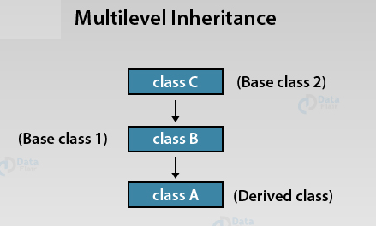
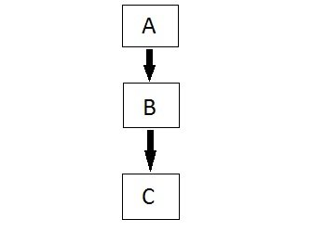
Multilevel Inheritance
In C++ programming, not only you can derive a class from the base class but you can also derive a class from the derived class. This form of inheritance is known as multilevel inheritance.
This type of inheritance is the best way to represent the transitive nature of inheritance. In multilevel inheritance, a derived class inherits all its properties from a class that itself inherits from another class.
18CSC202J - Object Oriented Design and Programming S - 1 & 3 / UNIT - 3

Slide 13
Multilevel Inheritance
Syntax
class A // Base class { // BODY OF CLASS A };
class B : acess_specifier A // Derived class of A { // BODY OF CLASS B };
class C : access_specifier B // Derived from derived class B { // BODY OF CLASS C };
18CSC202J - Object Oriented Design and Programming S - 1 & 3 / UNIT - 3

Slide 14
Multilevel Inheritance
multlevel.cpp
#include <iostream.H>
//using namespace std;
class Base
{
public:
int base_value;
void Base_input()
{
cout<<"Enter the integer value of base class: ";
cin>>base_value;
}
};
class Derived1 : public Base // Derived class of base class
{
public:
int derived1_value;
void Derived1_input()
{
cout<<"Enter the integer value of first derived class: ";
cin>>derived1_value;
}
};
class Derived2 : public Derived1 // Derived class of Derived1 class
{
// private by deafult
int derived2_value;
public:
void Derived2_input()
{
cout<<"Enter the integer value of the second derived class: ";
cin>>derived2_value;
}
void sum()
{
cout << "The sum of the three intger values is: " << base_value + derived1_value + derived2_value<<endl;
}
};
int main()
{
cout<<"Welcome to SRMIST"<<endl<<endl;
Derived2 d2; // Object d2 of second derived class
d2.Base_input();
d2.Derived1_input();
d2.Derived2_input();
d2.sum();
return 0;
}
18CSC202J - Object Oriented Design and Programming S - 1 & 3 / UNIT - 3

Slide 15
SLO-1 & SLO-2 : INHERITANCE : HIERARCHICAL, HYBRID, EXAMPLE PROGRAM
18CSC202J - Object Oriented Design and Programming S - 2 & 3 / UNIT - 3

Slide 16
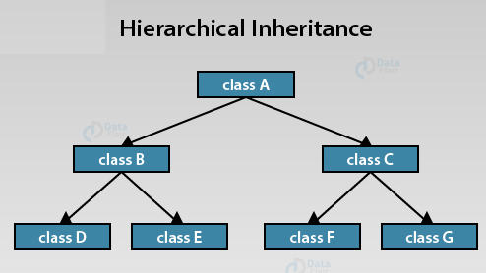
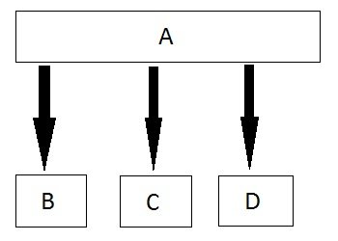
Hierarchical Inheritance
In this type of inheritance, multiple derived classes inherits from a single base class.
18CSC202J - Object Oriented Design and Programming S - 2 & 3 / UNIT - 3

Slide 17
Hierarchical Inheritance
Syntax
class A // Base class of B { // BODY OF THE PROGRAM };
class B : access_specifier A // Derived class of A { // BODY OF THE PROGRAM };
class C : access_specifier A // Derived class of A { // BODY OF THE PROGRAM };
class D : access_specifier A // Derived class of A { // BODY OF THE PROGRAM };
18CSC202J - Object Oriented Design and Programming S - 2 & 3 / UNIT - 3

Slide 18
Example : Hierarchical Inheritance
#include<conio.h>
class A
{
public:
int x, y;
void A_input()
{
cout<<"Enter two values of class A: ";
cin>>x>>y;
}
};
class B : public A // B is derived from A
{
public:
void product()
{
cout<<"The Product of the
two values is: "<< x * y<<endl;
}
};
class C : public A //C is derived from A
{
public:
void division()
{
cout<<"The Division of the two values is: "<< x / y<<endl;
}
};
int main()
{
clrscr();
cout<<“SRMISR"<<endl<<endl;
B b; // Object b of derived class B
C c; // Object c of derived class C
b.A_input();
b.product();
c.A_input();
c.division();
return 0;
}
18CSC202J - Object Oriented Design and Programming S - 2 & 3 / UNIT - 3

Slide 19
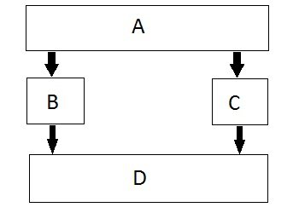
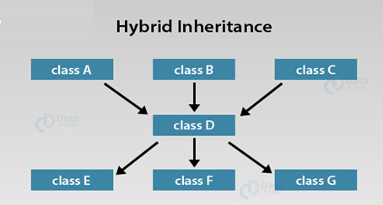
Hybrid (Virtual) Inheritance
Hybrid Inheritance is combination of Hierarchical and Mutilevel Inheritance.
This type of inheritance essentially combines more than two forms of inheritance. For instance, when a child class inherits from multiple base classes all of its parent classes and that child class itself serves as a base class for 3 of its derived classes.
18CSC202J - Object Oriented Design and Programming S - 2 & 3 / UNIT - 3

Slide 20
Hybrid (Virtual) Inheritance
Syntax :
class A { // BODY OF THE CLASS A };
class B : public A { // BODY OF THE CLASS A };
class C { // BODY OF THE CLASS A };
class D : public B, public C { // BODY OF THE CLASS A };
18CSC202J - Object Oriented Design and Programming S - 2 & 3 / UNIT - 3

Slide 21
Example of Hybrid Inheritance
#include <iostream.h>
//using namespace std;
class A
{
public:
int A_value;
};
class B : public A
{
public:
B() // Use of a constructor to initialize A_value
{
A_value = 20;
}
};
class C
{
public:
int C_value;
C() //Use of a constructor to initialize C_value
{
C_value = 40;
}
};
class D : public B, public C // D is derived from class B and class C
{
public:
void product()
{
cout<<"The product of the two integer values is: " << A_value * C_value<<endl;
}
};
int main()
{
cout<<"Welcome to SRMIST"<<endl<<endl;
D d; // Object d of derived class D
d.product();
return 0;
}
18CSC202J - Object Oriented Design and Programming S - 2 & 3 / UNIT - 3

Slide 22
SLO-1 : ADVANCED FUNCTIONS: inline, friend
18CSC202J - Object Oriented Design and Programming S - 6 / UNIT - 3

Slide 23
Friend function
1. The main concepts of the object oriented programming paradigm are data hiding and data encapsulation.
2. Whenever data variables are declared in a private category of a class, these members are restricted from accessing by non – member functions.
3. The private data values can be neither read nor written by non – member functions.
4. If any attempt is made directly to access these members, the compiler will display an error message as “inaccessible data type”.
5. The best way to access a private data member by a non – member function is to change a private data member to a public group.
6. When the private or protected data member is changed to a public category, it violates the whole concept or data hiding and data encapsulation.
7. To solve this problem, a friend function can be declared to have access to these data members.
8. Friend is a special mechanism for letting non – member functions access private data.
9. The keyword friend inform the compiler that it is not a member function of the class.
18CSC202J - Object Oriented Design and Programming S - 6 / UNIT - 3

Slide 24
Friend function
Granting Friendship to another Class
1. A class can have friendship with another class.
2. For Example, let there be two classes, first and second. If the class first grants its friendship with the other class second, then the private data members of the class first are permitted to be accessed by the public members of the class second. But on the other hand, the public member functions of the class first cannot access the private members of the class second.
Syntax
class second; forward declaration
class first
{
private:
--------------
18CSC202J - Object Oriented Design and Programming S - 6 / UNIT - 3

Slide 25
Friend functioniend classes
Two classes having the same Friend
1. A non – member function may have friendship with one or more classes.
2. When a function has declared to have friendship with more than one class, the friend classes should have forward declaration.
3. It implies that it needs to access the private members of both classes.
Syntax
friend return_type function_name(parameters);
Example
friend return_type fname(first one, second two)
{}
Note:
where friend is a keyword used as a function modifier. A friend declaration is valid only within or outside the class definition.
18CSC202J - Object Oriented Design and Programming S - 6 / UNIT - 3

Slide 26
Friend function
By default : functions and data of a class are private to that class
Only the public members are accessible outside the class
Protected members can be inherited along with public members
No such condition where private members can be accessed from outside the class
So Friend Functions and Friend Classes may be used where our application requires the access all the members of a class
18CSC202J - Object Oriented Design and Programming S - 6 / UNIT - 3

Slide 27
Features of Friend functions:
Not a member of the class
Invoked like normal function without any object
Full access to private and protected members
Of the class
But can use the members for one or more specific objects
Called without the use dot operator(does not need to be qualified with object’s name)
18CSC202J - Object Oriented Design and Programming S - 6 / UNIT - 3

Slide 28
How to declare?
Include its prototype in the class , preceding it with keyword friend
Syntax:
friend ret_type func_name(arguments);
Can be declared anywhere (in public, protected or private section) in the class
May have no arguments
Objects of the class or their pointers can be passed as arguments to the friend function
18CSC202J - Object Oriented Design and Programming S - 6 / UNIT - 3

Slide 29
Example:
Class myclass
{ int a,b;
Public:
myclass(int x,int y)
{ a=x; b=y; }
friend int sum(myclass m); // declaration
}
int sum(myclass m)
{ return m.a+ m.b; }
void main()
{ myclass my(10,20);
cout<<sum(my); //calling the friend function
}
18CSC202J - Object Oriented Design and Programming S - 6 / UNIT - 3

Slide 30
Example:
Syntax:
class second;forward declaration
class first
{
private:
--------------
public:
friend return_type fname(first one, second two);
};
class second
{
private:
------------------
public:
friend return_type fname(first one, second two);
};
Case 2:
class sample
{
private:
int x;
float y;
public:
virtual void display();
virtual static int sum();//error
}
int sample::sum()
{ }
18CSC202J - Object Oriented Design and Programming S - 6 / UNIT - 3

Slide 31
Example:
class sample
{
private:
int x;
public:
void getdata();
friend void display(sample abc);
};
void sample::getdata()
{
cout<<"Enter a value for x\n"<<endl;
cin>>x;
}
void display(sample abc)
{
cout<<"Entered Number is "<<abc.x<<endl;
}
void main()
{
clrscr();
sample obj;
obj.getdata();
cout<<"Accessing the private data by non - member function"<<endl;
display(obj);
getch();
}
18CSC202J - Object Oriented Design and Programming S - 6 / UNIT - 3

Slide 32
Example:
class first
{
friend class second;
private:
int x;
public:
void getdata();
};
class second
{
public:
void disp(first temp);
};
void first::getdata()
{
cout<<"Enter a Number ?"<<endl;
cin>>x;
}
void second::disp(first temp)
{
cout<<"Entered Number is = "<<temp.x<<endl;
}
void main()
{
first objx;
second objy;
objx.getdata();
objy.disp(objx);
}
18CSC202J - Object Oriented Design and Programming S - 6 / UNIT - 3

Slide 33
Usage of friend classes:
As a function can be friend of more than one class, it can be used for message passing between the classes.
As it is not a member of the class ,it does not have a this pointer. So can be used for Operator overloading. The operands are passed explicitly to the overloaded friend operator function.
Make I/O functions easier
18CSC202J - Object Oriented Design and Programming S - 6 / UNIT - 3

Slide 34
Example: Function As Friend Of More Than One Class
class A; // forward declaration
class B
{
int b;
friend int sum(A a1, B b1);
};
class A
{
int a;
friend int sum(A a1, B b1);
};
int sum (A a1,B b1)
{
return a1.a + b1.b;
}
18CSC202J - Object Oriented Design and Programming S - 6 / UNIT - 3

Slide 35
friend classes
One class friend of another class
Syntax: friend class class_name;
The friend class and all of its member functions have access to the private members defined within the other class
Provides additional functionality from outside the class
18CSC202J - Object Oriented Design and Programming S - 6 / UNIT - 3

Slide 36
Example: friend classes
Class one
{ int a;
friend class two;
};
Class two
{ void disp(one o1)
cout<<o1.a;
};
main()
{
two t;
one o;
t.disp(o);
}
18CSC202J - Object Oriented Design and Programming S - 6 / UNIT - 3

Slide 37
Inline Member Function
Inline functions are used in C++ to reduce the overhead of a normal function call.
A member function that is both declared and defined in the class member list is called an inline member function.
The inline specifier is a hint to the compiler that inline substitution of the function body is to be preferred to the usual function call implementation.
The advantages of using inline member functions are:
1. The size of the object code is considerably reduced.
2. It increases the execution speed, and
3. The inline member function are compact function calls.
18CSC202J - Object Oriented Design and Programming S - 6 / UNIT - 3

Slide 38
Inline Member Function
Syntax:
class user_defined_name
{
private:
-------------
public:
inline return_type function_name(parameters);
inline retrun_type function_name(parameters);
---------------
---------------
};
Syntax
Inline return_type function_name(parameters)
{
----------------
----------------
}
18CSC202J - Object Oriented Design and Programming S - 6 / UNIT - 3

Slide 39
Compiler may not perform inlining in such circumstances like:
If a function contains a loop. (for, while, do-while)
If a function contains static variables.
If a function is recursive.
If a function return type is other than void, and the return statement doesn’t exist in function body.
If a function contains switch or goto statement.
18CSC202J - Object Oriented Design and Programming S - 6 / UNIT - 3

Slide 40
Example :
#include <iostream>
using namespace std;
inline int cube(int s)
{
return s*s*s;
}
int main()
{
cout << "The cube of 3 is: " << cube(3) << "\n";
return 0;
}
//Output: The cube of 3 is: 27
18CSC202J - Object Oriented Design and Programming S - 6 / UNIT - 3

Slide 41
Inline function and classes
It is also possible to define the inline function inside the class.
All the functions defined inside the class are implicitly inline. Thus, all the restrictions of inline functions are also applied here.
If you need to explicitly declare inline function in the class then just declare the function inside the class and define it outside the class using inline keyword
18CSC202J - Object Oriented Design and Programming S - 6 / UNIT - 3

Slide 42
Inline function and classes
#include <iostream>
using namespace std;
class operation
{
int a,b,add;
public:
void get();
void sum();
};
inline void operation :: get()
{
cout << "Enter first value:";
cin >> a;
cout << "Enter second value:";
cin >> b;
}
inline void operation :: sum()
{
add = a+b;
cout << "Addition of two numbers: " << a+b << "\n";
}
int main()
{
cout << "Program using inline function\n";
operation s;
s.get();
s.sum();
return 0;
}
Output:
Enter first value: 45 Enter second value: 15 Addition of two numbers: 60 Difference of two numbers: 30 Product of two numbers: 675 Division of two numbers: 3
18CSC202J - Object Oriented Design and Programming S - 6 / UNIT - 3

Slide 43
SLO-2 : ADVANCED FUNCTIONS: virtual, overriding
18CSC202J - Object Oriented Design and Programming S - 6 / UNIT - 3

Slide 44
Polymorphism in C++: VIRTUAL FUNCTIONS
2 types
Compile time polymorphism
Uses static or early binding
Example: Function and operator overloading
Run time polymorphism
Uses dynamic or early binding
Example: Virtual functions
18CSC202J - Object Oriented Design and Programming S - 6 / UNIT - 3

Slide 45
Pointers to Derived Classes
C++ allows base class pointers to point to derived class objects.
Let we have –
class base { … };
class derived : public base { … };
Then we can write –
base *p1; derived d_obj; p1 = &d_obj;
base *p2 = new derived;
18CSC202J - Object Oriented Design and Programming S - 6 / UNIT - 3

Slide 46
Pointers to Derived Classes (contd.)
Using a base class pointer (pointing to a derived class object) we can access only those members of the derived object that were inherited from the base.
This is because the base pointer has knowledge only of the base class.
It knows nothing about the members added by the derived class.
18CSC202J - Object Oriented Design and Programming S - 6 / UNIT - 3

Slide 47
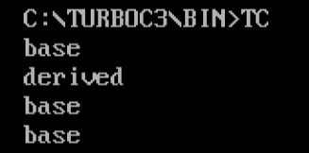
Pointers to Derived Classes (contd.)
virtual2.cpp
#include<iostream.h>
class base {
public:
void show() {
cout << “base\n”;
}
};
class derived : public base {
public:
void show() {
cout << “derived\n”;
}
};
void main() {
base b1;
b1.show(); // base
derived d1;
d1.show(); // derived
base *pb = &b1;
pb->show(); // base
pb = &d1;
pb->show(); // base
}
****All the function calls here are statically bound
18CSC202J - Object Oriented Design and Programming S - 6 / UNIT - 3

Slide 48
Pointers to Derived Classes (contd.)
While it is permissible for a base class pointer to point to a derived object, the reverse is not true.
base b1;
derived *pd = &b1; // compiler error
18CSC202J - Object Oriented Design and Programming S - 6 / UNIT - 3

Slide 49
Introduction to Virtual Functions
A virtual function is a member function that is declared within a base class and redefined (called overriding) by a derived class.
It implements the “one interface, multiple methods” philosophy that underlies polymorphism.
The keyword virtual is used to designate a member function as virtual.
Supports run-time polymorphism with the help of base class pointers.
18CSC202J - Object Oriented Design and Programming S - 6 / UNIT - 3

Slide 50
Introduction to Virtual Functions
While redefining a virtual function in a derived class, the function signature must match the original function present in the base class.
So, we call it overriding, not overloading.
When a virtual function is redefined by a derived class, the keyword virtual is not needed (but can be specified if the programmer wants).
The “virtual”-ity of the member function continues along the inheritance chain.
A class that contains a virtual function is referred to as a polymorphic class.
18CSC202J - Object Oriented Design and Programming S - 6 / UNIT - 3

Slide 51
Virtual function
Syntax
virtual return_type function_name (arg);
Example
virtual void show()
{
cout << "Base class\n";
}
Note:
We can call private function of derived class from the base class pointer with the help of virtual keyword. Compiler checks for access specifier only at compile time. So at run time when late binding occurs it does not check whether we are calling the private function or public function.
18CSC202J - Object Oriented Design and Programming S - 6 / UNIT - 3

Slide 52
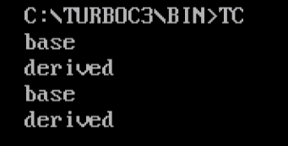
Introduction to Virtual Functions
virtual1.cpp
void main() {
base b1;
b1.show(); // base - (s.b.)
derived d1;
d1.show(); // derived – (s.b.)
base *pb = &b1;
pb->show(); // base - (d.b.)
pb = &d1;
pb->show(); // derived (d.b.)
}
Here,
s.b. = static binding
d.b. = dynamic binding
#include<iostream.h>
class base {
public:
virtual void show() {
cout << “base\n”;
}
};
class derived : public base {
public:
void show() {
cout << “derived\n”;
}
};
18CSC202J - Object Oriented Design and Programming S - 6 / UNIT - 3

Slide 53
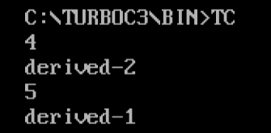
Introduction to Virtual Functions
virtual3.cpp
class d2 : public base {
public:
void show() {
cout << “derived-2\n”;
}
};
void main() {
base *pb; d1 od1; d2 od2;
int n;
cin >> n;
if (n % 2) pb = &od1;
else pb = &od2;
pb->show(); // guess what ??
}
#include<iostream.h>
class base {
public:
virtual void show() {
cout << “base\n”;
}
};
class d1 : public base {
public:
void show() {
cout << “derived-1\n”;
}
};
Run-time polymorphism
18CSC202J - Object Oriented Design and Programming S - 6 / UNIT - 3

Slide 54
Virtual function
Virtual Function is a function in base class, which is overridden in the derived class, and which tells the compiler to perform Late Binding on this function.
Virtual Keyword is used to make a member function of the base class Virtual. Virtual functions allow the most specific version of a member function in an inheritance hierarchy to be selected for execution. Virtual functions make polymorphism possible.
Key:
Only the Base class Method's declaration needs the Virtual Keyword, not the definition.
If a function is declared as virtual in the base class, it will be virtual in all its derived classes.
18CSC202J - Object Oriented Design and Programming S - 6 / UNIT - 3

Slide 55
Virtual function features
Case 1:
class sample
{
private:
int x;
float y;
public:
virtual void display();
virtual int sum();
}
virtual void sample::display()//Error
{ }
Case 2:
class sample
{
private:
int x;
float y;
public:
virtual void display();
virtual static int sum(); //error
}
int sample::sum()
{ }
18CSC202J - Object Oriented Design and Programming S - 6 / UNIT - 3

Slide 56
Virtual function features
Case 3:
class sample
{
private:
int x;
float y;
public:
virtual sample(int x,float y); //error constructor
void display(); int sum();
}
Case 4:
class sample
{
private:
int x;
float y;
public:
virtual ~sample(int x,float y); //invalid
void display();
int sum();
}
18CSC202J - Object Oriented Design and Programming S - 6 / UNIT - 3

Slide 57
Virtual function features
Case 5:
class sample_1
{
private:
int x;
float y;
public:
virtual int sum(int x,float y);
};
class sample_2:public sample_1
{
private:
int z;
public:
virtual float sum(int xx,float yy); //error
};
Case 6:
virtual void display() //Error, non member function
{
----------------
----------------
}
18CSC202J - Object Oriented Design and Programming S - 6 / UNIT - 3

Slide 58
Representing Shapes
shape
inherits (isa)
rectangle
• • • •
triangle
circle
square
18CSC202J - Object Oriented Design and Programming S - 6 / UNIT - 3

Slide 59
Representing Shapes (shape.cpp)
#include <iostream.h>
//using namespace std;
class Polygon {
protected:
int width, height;
public:
void set_values (int a, int b)
{ width=a; height=b; }
virtual int area ()
{ return 0; }
};
class Rectangle: public Polygon {
public:
int area ()
{ return width * height; }
};
class Triangle: public Polygon {
public:
int area ()
{ return (width * height / 2); }
};
int main () {
Rectangle rect;
Triangle trgl;
Polygon poly;
Polygon * ppoly1 = &rect;
Polygon * ppoly2 = &trgl;
Polygon * ppoly3 = &poly;
ppoly1->set_values (4,5);
ppoly2->set_values (4,5);
ppoly3->set_values (4,5);
cout << ppoly1->area() << '\n';
cout << ppoly2->area() << '\n';
cout << ppoly3->area() << '\n';
return 0;
}
18CSC202J - Object Oriented Design and Programming S - 6 / UNIT - 3

Slide 60
Difference in invocation for virtual and non virtual function
class Base
{ public:
void show()
{
cout << "Base class";
}
};
class Derived:public Base
{ public:
void show()
{
cout << "Derived Class";
}
}
int main()
{
Base* b; //Base class pointer
Derived d; //Derived class object
b = &d;
b->show(); //Early Binding Occurs
}
class Base
{ public:
virtual void show()
{
cout << "Base class\n";
} };
class Derived:public Base
{ public:
void show()
{
cout << "Derived Class";
} };
int main()
{
Base* b; //Base class pointer
Derived d; //Derived class object
b = &d;
b->show(); //Late Binding Occurs
}
18CSC202J - Object Oriented Design and Programming S - 6 / UNIT - 3

Slide 61
Virtual Destructors
Constructors cannot be virtual, but destructors can be virtual.
It ensures that the derived class destructor is called when a base class pointer is used while deleting a dynamically created derived class object.
18CSC202J - Object Oriented Design and Programming S - 6 / UNIT - 3

Slide 62
Virtual Destructors (contd.)
vir_des.cpp
#include<iostream.h>
class base {
public:
~base() {
cout << “destructing base\n”;
}
};
class derived : public base {
public:
~derived() {
cout << “destructing derived\n”;
}
};
void main() {
base *p = new derived;
delete p;
}
Output:
destructing base
18CSC202J - Object Oriented Design and Programming S - 6 / UNIT - 3

Slide 63
Virtual Destructors (contd.)
vir_des1.cpp
#include<iostream.h>
class base {
public:
virtual ~base() {
cout << “destructing base\n”;
}
};
class derived : public base {
public:
~derived() {
cout << “destructing derived\n”;
}
};
void main() {
base *p = new derived;
delete p;
}
Output:
destructing derived
destructing base
18CSC202J - Object Oriented Design and Programming S - 6 / UNIT - 3

Slide 64
More About Virtual Functions
If we want to omit the body of a virtual function in a base class, we can use pure virtual functions.
virtual ret-type func-name(param-list) = 0;
It makes a class an abstract class.
We cannot create any objects of such classes.
It forces derived classes to override it.
Otherwise they become abstract too.
18CSC202J - Object Oriented Design and Programming S - 6 / UNIT - 3

Slide 65
More About Virtual Functions (contd.)
Pure virtual function
Helps to guarantee that a derived class will provide its own redefinition.
We can still create a pointer to an abstract class
Because it is at the heart of run-time polymorphism
When a virtual function is inherited, so is its virtual nature.
We can continue to override virtual functions along the inheritance hierarchy
18CSC202J - Object Oriented Design and Programming S - 6 / UNIT - 3

Slide 66
Final Comments
Run-time polymorphism is not automatically activated in C++.
We have to use virtual functions and base class pointers to enforce and activate run-time polymorphism in C++.
18CSC202J - Object Oriented Design and Programming S - 6 / UNIT - 3

Slide 67
Final Comments
Early binding
Normal functions, overloaded functions
Nonvirtual member and friend functions
Resolved at compile time
Very efficient
But lacks flexibility
Late binding
Virtual functions accessed via a base class pointer
Resolved at run-time
Quite flexible during run-time
But has run-time overhead; slows down program execution
18CSC202J - Object Oriented Design and Programming S - 6 / UNIT - 3

Slide 68
Overriding
#include <iostream>
using namespace std;
class Base {
public:
// user wants to override this in the derived class
virtual void func()
{
cout << "I am in base" << endl;
}
};
class derived : public Base {
public:
// did a mistake by putting an argument "int a"
void func(int a) //override
{
cout << "I am in derived class" << endl;
}
};
int main()
{
Base b;
derived d;
cout << "Compiled successfully" << endl;
return 0;
}
Output:
Base::foo
Derived::bar
18CSC202J - Object Oriented Design and Programming S - 6 / UNIT - 3

Slide 69
SLO-1 & SLO-2: ADVANCED FUNCTION: pure virtual function, Example for virtual and pure virtual function
18CSC202J - Object Oriented Design and Programming S - 7 / UNIT - 3

Slide 70
Pure virtual function
Pure virtual Functions are virtual functions with no definition. They start with virtual keyword and ends with = 0. Here is the syntax for a pure virtual function.
Pure Virtual functions can be given a small definition in the Abstract class, which you want all the derived classes to have. Still you cannot create object of Abstract class.
Also, the Pure Virtual function must be defined outside the class definition. If you will define it inside the class definition, complier will give an error. Inline pure virtual definition is Illegal.
Abstract Class is a class which contains atleast one Pure Virtual function in it. Abstract classes are used to provide an Interface for its sub classes. Classes inheriting an Abstract Class must provide definition to the pure virtual function, otherwise they will also become abstract class.
18CSC202J - Object Oriented Design and Programming S - 7 / UNIT - 3

Slide 71
Pure virtual function
Syntax
virtual void f() = 0;
class Base
{
public:
virtual void show() = 0; // Pure Virtual Function
};
Note:
We can call private function of derived class from the base class pointer with the help of virtual keyword. Compiler checks for access specifier only at compile time. So at run time when late binding occurs it does not check whether we are calling the private function or public function.
18CSC202J - Object Oriented Design and Programming S - 7 / UNIT - 3

Slide 72
Example :Pure Virtual function…
class pet
{
private:
char name[5];
public:
virtual void getdata()=0;
virtual void display()=0;
};
class fish:public pet
{
private:
char environment[10];
char food[10];
public:
void getdata();
void display();
};
class dog: public pet
18CSC202J - Object Oriented Design and Programming S - 7 / UNIT - 3

Slide 73
Example :Pure Virtual function…
private:
char environment[10];
char food[10];
public:
void getdata();
void display();
};
void fish::getdata()
{
cout<<"Enter the Fish Environment required"<<endl;
cin>>environment;
cout<<"Enter the Fish food require"<<endl;
cin>>food;
}
18CSC202J - Object Oriented Design and Programming S - 7 / UNIT - 3

Slide 74
Example :Pure Virtual function…
private:
char environment[10];
char food[10];
public:
void getdata();
void display();
};
void fish::getdata()
{
cout<<"Enter the Fish Environment required"<<endl;
cin>>environment;
cout<<"Enter the Fish food require"<<endl;
cin>>food;
}
void dog::getdata()
{
cout<<"Enter the Dog Environment required"<<endl;
cin>>environment;
cout<<"Enter the Dog Food require"<<endl;
cin>>food;
}
18CSC202J - Object Oriented Design and Programming S - 7 / UNIT - 3

Slide 75
Example :Pure Virtual function.
void dog::display()
{
cout<<"Dog Environment="<<environment<<endl;
cout<<"Dog Food="<<food<<endl;
cout<<"---------------------------------------"<<endl;
}
void main()
{
pet *ptr;
fish f;
ptr=&f;
ptr->getdata();
ptr->display();
dog d;
ptr=&d;
ptr->getdata();
ptr->display();
getch();
}
18CSC202J - Object Oriented Design and Programming S - 7 / UNIT - 3

Slide 76
Pure Virtual function with definition
Pure Virtual function is allowed to have definition in the base class itself, but the definition has to be made outside the class using scope resolution operator. Since inline pure virtual not supported compiler throws an error message.
Pure virtual definition is useful when all the child will have certain common behavior to be implemented.
#include <iostream>
using namespace std;
class Base
{
public:
virtual void display()=0;
};
void Base::display()
{
cout<<"Base class version of pure virtual";
}
class Derived:public Base
{
public:
void display()
{
cout<<"Derived Version of pure virtual function";
}
};
int main()
{
Derived ob;
Base *p;
p = &ob;
p->display();
return 0;
}
18CSC202J - Object Oriented Design and Programming S - 7 / UNIT - 3

Slide 77
Pure Virtual function with definition
Pure virtual implementation of base class version is called inside the override version of derived class method using class name and scope resolution operator
void display()
{
Base:: display();
cout<<"Derived Version of pure virtual function";
}
};
int main()
{
Derived ob;
Base *p;
p = &ob;
p->display();
return 0;
}
#include <iostream>
using namespace std;
class Base
{
public:
virtual void display()=0;
};
void Base::display()
{
cout<<"Base class version of pure virtual";
}
class Derived:public Base
{
public:
18CSC202J - Object Oriented Design and Programming S - 7 / UNIT - 3

Slide 78
Pure Virtual function with definition
Suppose that you’re modelling a game system for an epic adventure, and your game has a variety of weapons (swords, arrows etc) that the hero uses to save the world from the evil.
You’ve decided to create an interface Weapon that models the abstract concept that must be the base for your weapons system. This interface offers the abstract member function attack and it needs to be completed by every concrete weapon in the game. The Weapon concept doesn’t have a concrete meaning, but perhaps it’s reasonable to have a default behavior for the attack that the concrete classes may use.
18CSC202J - Object Oriented Design and Programming S - 7 / UNIT - 3

Slide 79
Pure Virtual function with definition
#include <iostream>
class Weapon {
public:
virtual ~Weapon() = default;
virtual void attack() const = 0;
};
void Weapon::attack() const
{
std::cout << "Default attack..\n";
}
class Sword : public Weapon
{
public:
void attack() const override
{
// Calls default member function (Weapon::attack)
Weapon::attack();
std::cout << "Sword attack...\n";
}
};
18CSC202J - Object Oriented Design and Programming S - 7 / UNIT - 3

Slide 80
SLO-1 & SLO-2 : Abstract class and Interface, Example Program
18CSC202J - Object Oriented Design and Programming S - 8 / UNIT - 3

Slide 81
ABSTRACT BASE CLASSES
An abstract class is a class that is specifically defined to lay a foundation for other classes that exhibits a common behavior or similar characteristics.
It is primarily used only as a base class for inheritance.
Since an abstract class is an incomplete class, users are not allowed to create its object.
To use such a class, programmers must derive it, keeping in mind that they must implement all pure virtual functions specified in that class.
18CSC202J - Object Oriented Design and Programming S - 8 / UNIT - 3

Slide 82
Abstract class
An abstract class is, conceptually, a class that cannot be instantiated and is usually implemented as a class that has one or more pure virtual (abstract) functions.
A pure virtual function is one which must be overridden by any concrete (i.e., non-abstract) derived class.
This is indicated in the declaration with the syntax " = 0" in the member function's declaration.
18CSC202J - Object Oriented Design and Programming S - 8 / UNIT - 3

Slide 83
Abstract class
Abstract class cannot be instantiated, but pointers and references of Abstract class type can be created.
Abstract class can have normal functions and variables along with a pure virtual function.
Abstract classes are mainly used for Upcasting, so that its derived classes can use its interface.
Classes inheriting an Abstract Class must implement all pure virtual functions, or else they will become Abstract too.
18CSC202J - Object Oriented Design and Programming S - 8 / UNIT - 3

Slide 84
ABSTRACT BASE CLASSES contd.
Features
• Abstract base classes have at least one pure virtual function
• Classes inheriting abstract classes must either define all pure virtual functions or must themselves become an abstract class.
• There can be no object of an abstract class.
• Pointers or references to abstract classes can be created.
• An abstract class can have other data members and member functions in addition to the pure virtual functions.
18CSC202J - Object Oriented Design and Programming S - 8 / UNIT - 3

Slide 85
Abstract class
class AbstractClass {
public:
virtual void AbstractMemberFunction() = 0; // Pure virtual function makes
// this class Abstract class.
virtual void NonAbstractMemberFunction1(); // Virtual function.
void NonAbstractMemberFunction2();
};
In general an abstract class is used to define an implementation and is intended to be inherited from by concrete classes. It's a way of forcing a contract between the class designer and the users of that class
18CSC202J - Object Oriented Design and Programming S - 8 / UNIT - 3

Slide 86
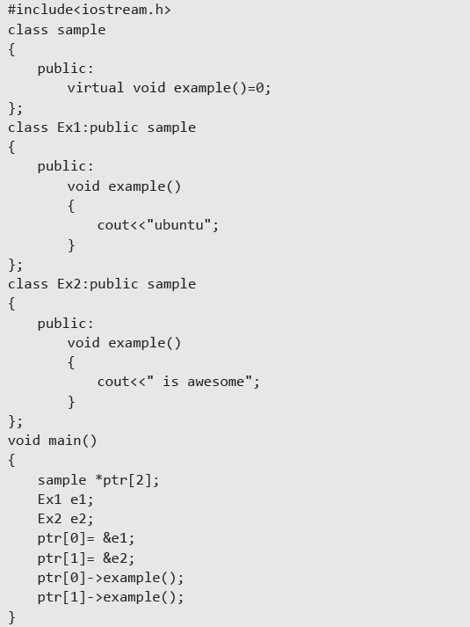
Example : Abstract Base Classes
18CSC202J - Object Oriented Design and Programming S - 8 / UNIT - 3

Slide 87
Interface
In C++, there is a way to describe the behaviour of a class without committing to a particular implementation of that class.
This feature is offered by C++ objects and classes. Using abstract classes, you can implement the C++ interfaces.
18CSC202J - Object Oriented Design and Programming S - 8 / UNIT - 3

Slide 88
Interface
An interface has no implementation.
An interface class contains only a virtual destructor and pure virtual functions.
An interface class is a class that specifies the polymorphic interface i.e. pure virtual function declarations into a base class.
The programmer using a class hierarchy can then do so via a base class that communicates only the interface of classes in the hierarchy.
18CSC202J - Object Oriented Design and Programming S - 8 / UNIT - 3

Slide 89
Interface
class shape // An interface class
{
public:
virtual ~shape();
virtual void move_x(int x) = 0;
virtual void move_y(int y) = 0;
virtual void draw() = 0;
//...
};
18CSC202J - Object Oriented Design and Programming S - 8 / UNIT - 3

Slide 90
Interface
class shape // An interface class
{
public:
virtual ~shape();
virtual void move_x(int x) = 0;
virtual void move_y(int y) = 0;
virtual void draw() = 0;
//...
};
Every interface class should have a virtual destructor. Virtual destructor makes sure that when a shape is deleted polymorphically, correct destructor of the derived class is invoked.
18CSC202J - Object Oriented Design and Programming S - 8 / UNIT - 3

Slide 91
Importance of C++ Interface
Suppose, you created a class named OS with data members Windows, Linux and Mac with member functions such as size(), type() and feature().
Let’s say that the size of each operating system is fixed and cannot be altered.
But different operating systems have different sizes.
In one way, you can implement the class OS for the function size() by making this function abstract. In this way, we can make sure that the size of all operating systems is fixed.
18CSC202J - Object Oriented Design and Programming S - 8 / UNIT - 3

Slide 92
Follow the rules before using C++ Interfaces
You should follow the rules before working with the interfaces in the C++ programming language.
1. You can only declare a pure virtual function but you cannot define it.
2. You can only assign 0 to the pure virtual function.
3. Also you cannot create an instance of a class.
4. You can create a pointer to the instance of the derived class with a reference of base abstract class.
18CSC202J - Object Oriented Design and Programming S - 8 / UNIT - 3

Slide 93
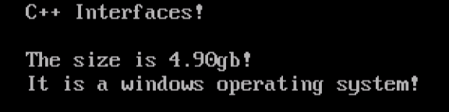
Importance of C++ Interface
#include <iostream>
using namespace std;
class OS
{
public:
virtual void size() = 0;
void type()
{
cout<<"It is a windows operating system!"<<endl;
}
};
class Windows: public OS
{
public:
void size()
{
cout<<"The size is 4.90gb!"<<endl;
}
};
int main()
{
cout<<" C++ Interfaces!"<<endl<<endl;
Windows data;
data.size();
data.type();
return 0;
}
18CSC202J - Object Oriented Design and Programming S - 8 / UNIT - 3

Slide 94
Differences
- interfaces can have no state or implementation
- a class that implements an interface must provide an implementation of all the method of that interface
- abstract classes may contain state (data members) and/or implementation (methods)
- abstract classes can be inherited without implementing the abstract methods (though such a derived class is abstract itself)
- interfaces may be multiple-inherited, abstract classes may not
18CSC202J - Object Oriented Design and Programming S - 8 / UNIT - 3

Slide 95
Differences
7 - If you anticipate creating multiple versions of your component, create an abstract class.
Abstract classes provide a simple and easy way to version your components.
By updating the base class, all inheriting classes are automatically updated with the change.
Interfaces, on the other hand, cannot be changed once created. If a new version of an interface is required, you must create a whole new interface.
8 -If the functionality you are creating will be useful across a wide range of disparate objects, use an interface.
Abstract classes should be used primarily for objects that are closely related, whereas interfaces are best suited for providing common functionality to unrelated classes.
18CSC202J - Object Oriented Design and Programming S - 8 / UNIT - 3

Slide 96
MCQs
A class is made abstract by declaring at least one of its functions as?
A. impure virtual function B. pure virtual function C. pure abstract function D. impure abstract function
Ans : B Explanation: A class is made abstract by declaring at least one of its functions as pure virtual function
18CSC202J - Object Oriented Design and Programming S - 8 / UNIT - 3

Slide 97
MCQs
A pure virtual function is specified by placing?
A. -1 B. 0 C. 1 D. infinite
Ans:B Explanation: A pure virtual function is specified by placing "= 0" in its declaration
18CSC202J - Object Oriented Design and Programming S - 8 / UNIT - 3

Slide 98
MCQs
Syntax for Pure Virtual Function is ______________ .
a. virtual void show()==0
b. void virtual show()==0
c. virtual void show()=0
d. void virtual show()=0
Ans:C virtual void show()=0
18CSC202J - Object Oriented Design and Programming S - 8 / UNIT - 3

Slide 99
MCQs
Classes that can be used to instantiate objects are called?
A. concrete classes B. interface C. abstract class D. None of the above
Ans : A Explanation: Classes that can be used to instantiate objects are called concrete classes.
18CSC202J - Object Oriented Design and Programming S - 8 / UNIT - 3

Slide 100
MCQs
Which class is used to design the base class?
A. abstract class B. derived class C. base class D. derived & base class
Ans : A Explanation: Abstract class is used to design base class because functions of abstract class can be overridden in derived class hence derived class from same base class can have common method with different implementation, hence forcing encapsulation.
18CSC202J - Object Oriented Design and Programming S - 8 / UNIT - 3

Slide 101
MCQs
Which is the correct syntax of defining a pure virtual function?
A. pure virtual return_type func(); B. virtual return_type func() pure; C. virtual return_type func() = 0; D. virtual return_type func();
Ans : C Explanation: virtual return_type function_name(parameters) = 0;
where {=0} is called pure specifier.
18CSC202J - Object Oriented Design and Programming S - 8 / UNIT - 3

Slide 102
MCQs
Which is the correct syntax of defining a pure virtual function?
A. pure virtual return_type func(); B. virtual return_type func() pure; C. virtual return_type func() = 0; D. virtual return_type func();
Ans : C Explanation: virtual return_type function_name(parameters) = 0;
where {=0} is called pure specifier.
18CSC202J - Object Oriented Design and Programming S - 8 / UNIT - 3

Slide 103
MCQs
_______________ is a member function that is declared within a base class and redefined by derived class.
a. virtual function
b. static function
c. friend function
d. const member function
ANSWER: a ) virtual function
18CSC202J - Object Oriented Design and Programming S - 8 / UNIT - 3

Slide 104
MCQs
which of the following is used to implement the c++ interfaces?
A. absolute variables
B. abstract classes
C. constant variables
D. none of the mentioned
ANSWER: B ) abstract classes
18CSC202J - Object Oriented Design and Programming S - 8 / UNIT - 3

Slide 105
MCQs
Interface class in C++ is created by
Using interface keyword before class
Using pure virtual function
Using pure virtual function and virtual function both
Using class keyword
ANSWER: 2 )
18CSC202J - Object Oriented Design and Programming S - 8 / UNIT - 3

Slide 106
MCQs
Which statements are true about an abstract class
Abstract class has at least one pure virtual function.
Pointer for an abstract class can be created
Object of an abstract class cannot be created.
All are correct.
ANSWER: 4 )
18CSC202J - Object Oriented Design and Programming S - 8 / UNIT - 3

Slide 107
MCQs
#include<iostream>
class test{
public:
test(){
std::cout<<"test";
}
~test(){
std::cout<<"~test";
}
virtual void myfunc() = 0;
};
int main(){
test obj;
return 0;
}
Ans : A
(A) error: cannot declare variable ‘obj’ to be of abstract type ‘test’ (B) test (C) ~test (D) test~test
18CSC202J - Object Oriented Design and Programming S - 8 / UNIT - 3

Slide 108
What is this pointer in C++?
Example
#include<iostream.h>
#include<conio.h>
class A{
private:
int value;
public:
int setvalue(int x){
int setvalue(int x);
return (this->value=x);
}
};
int main()
{
A a;
int m,n;
clrscr();
m= a.setvalue(5);
n=a.setvalue(10);
cout<<endl<<"m="<<m<<endl<<"n="<<n;
return 0;
}
The member functions of every object have a pointer named this, which points to the object itself. The value of this is set to the address of the object for which it is called. It can be used to access the data in the object it points to.

Slide 109
SLO-1 & SLO-2 : UML STATE CHART DIAGRAM, SLO-1 : EXAMPLE STATE CHART DIAGRAM
18CSC202J - Object Oriented Design and Programming S - 11 & 12 / UNIT - 3

Slide 110
UML State chart Diagram (STD)
Shows the sequences of states that objects of a class go through during its life cycle in response to external events and also the responses and actions in reaction to an event.
Model elements
States
Transitions
Events
Actions and activities
18CSC202J - Object Oriented Design and Programming S - 11 & 12 / UNIT - 3

Slide 111
STD Elements
A Event - is a significant or noteworthy occurrence
e.g. a phone receiver is taken off the hook
A State - is the condition of an object at a moment in time
- the time between events.
e.g. a phone is in the state of being “idle” after the receiver is placed on the hook until it is taken off the hook.
A transition - is a relationship between two states that indicates that when an event occurs, the object moves from the prior state to the subsequent state.
e.g. when the the event “off hook” occurs, transition the phone from the “idle” to “active” state.
18CSC202J - Object Oriented Design and Programming S - 11 & 12 / UNIT - 3

Slide 112
Statechart Diagram Notation
A Statechart Diagram describes the temporal evolution of an object of a given class in response to interactions with other objects inside or outside the system.
An event is a one-way (asynchronous) communication from one object to another:
atomic (non-interruptible)
includes events from hardware and real-world objects e.g., message receipt, input event, elapsed time, ...
notation: eventName(parameter: type, ...)
may cause object to make a transition between states
18CSC202J - Object Oriented Design and Programming S - 11 & 12 / UNIT - 3

Slide 113
State chart Diagram Notation…
A state is a period of time during which an object is waiting for an event to occur:
depicted as rounded box with (up to) three sections:
name — optional
state variables — name: type = value (valid only for that state)
triggered operations — internal transitions and ongoing operations
may be nested
18CSC202J - Object Oriented Design and Programming S - 11 & 12 / UNIT - 3

Slide 114
State Diagrams (Billing Example)
State Diagrams show the sequences of states an object goes through during its life cycle in response to stimuli, together with its responses and actions; an abstraction of all possible behaviors.
Start
End
Unpaid
Paid
Invoice created
paying
Invoice destroying
18CSC202J - Object Oriented Design and Programming S - 11 & 12 / UNIT - 3

Slide 115
State Diagrams (Traffic light example)
Traffic Light
Start
State
Red
Transition
Yellow timer expires
Car trips sensor
Yellow
Green timer expires
Green
Event
18CSC202J - Object Oriented Design and Programming S - 11 & 12 / UNIT - 3

Slide 116
Example: STD for a Phone
Initial state
transition
event
state
off hook
Idle
Active
on hook
18CSC202J - Object Oriented Design and Programming S - 11 & 12 / UNIT - 3

Slide 117
Classes that Need State Diagrams
State-dependent classes
objects react differently to events depending on their state
State-independent classes do not need State Diagrams
an object always responds the same way to an event
18CSC202J - Object Oriented Design and Programming S - 11 & 12 / UNIT - 3

Slide 118
Event Types
External Event (also known as system event)
is caused by something outside the system boundary
e.g. when a cashier presses the “enter item” button on a POST, an external event has occurred.
Internal Event
is caused by something inside our system boundary.
In terms of SW, an internal event arises when an operation is invoked via a message sent from another internal object. (The messages in collaboration diagrams suggest internal events)
Temporal Event
is caused by the occurrence of a specific date and time or passage of time.
18CSC202J - Object Oriented Design and Programming S - 11 & 12 / UNIT - 3

Slide 119
State
Abstraction of attribute values and links of an object
Sets of values are grouped together into a state
Corresponds to the interval between two events received by the object
events represent points in time
states represent intervals of time
Has duration
18CSC202J - Object Oriented Design and Programming S - 11 & 12 / UNIT - 3

Slide 120
State
Often associated with a
continuous activity
value satisfying some condition
Event separates two states
State separates two events
18CSC202J - Object Oriented Design and Programming S - 11 & 12 / UNIT - 3

Slide 121
State Diagram
Graph relating events and states
Nodes are states; arcs are events
Describes behaviour of a single class of objects
Can represent
one-shot life cycles
continuous loops
18CSC202J - Object Oriented Design and Programming S - 11 & 12 / UNIT - 3

Slide 122
State Diagram
Continuous loop
graph is a loop
no definite start state
not concerned about how the loop starts
18CSC202J - Object Oriented Design and Programming S - 11 & 12 / UNIT - 3

Slide 123
Example
Event
Transition
digit (n)
State
digit (n)
dial tone
dialling
on-hook
off-hook
on-hook
idle
18CSC202J - Object Oriented Design and Programming S - 11 & 12 / UNIT - 3

Slide 124
State Diagram
One-shot life cycle
represents objects with finite lives
initial state entered on creation of object
entering final state destroys object
initial state shown using solid circle
final state(s) shown using bull’s eye
18CSC202J - Object Oriented Design and Programming S - 11 & 12 / UNIT - 3

Slide 125
Example
Black wins
White’s move
start
stalemate
black
moves
white
moves
Draw
stalemate
Black’s move
White wins
18CSC202J - Object Oriented Design and Programming S - 11 & 12 / UNIT - 3

Slide 126
Transition Actions, Guard Conditions
Transition Actions
a transition can cause an action to fire. In SW, this may represent the invocation of a method of an object
Transition Guard conditions
a transition may also have a conditional guard -- or boolean test. The transition is only taken if the test passes.
18CSC202J - Object Oriented Design and Programming S - 11 & 12 / UNIT - 3

Slide 127
Transition Action and Guards
event
action
off hook / play dial tone
Idle
[ valid subscriber ]
Active
on hook
guard condition
18CSC202J - Object Oriented Design and Programming S - 11 & 12 / UNIT - 3

Slide 128
Guard Condition
Boolean function of object values
Valid over an interval of time
Can be used as guards on transitions
Guard condition shown in brackets, following event name
18CSC202J - Object Oriented Design and Programming S - 11 & 12 / UNIT - 3

Slide 129
Example
Guard condition
login
[user name]
password
18CSC202J - Object Oriented Design and Programming S - 11 & 12 / UNIT - 3

Slide 130
Operations
Attached to states or transitions
Performed in response to corresponding states or events
Types
Activity
Action
18CSC202J - Object Oriented Design and Programming S - 11 & 12 / UNIT - 3

Slide 131
Operations
Activity
operation that takes time to complete
associated with a state
include continuous or sequential operations
notation “do: A” within a state box
indicates activity A
starts on entry
ends on exit
18CSC202J - Object Oriented Design and Programming S - 11 & 12 / UNIT - 3

Slide 132
Example - State Activities
login
do : display login prompt
password
do: get password
18CSC202J - Object Oriented Design and Programming S - 11 & 12 / UNIT - 3

Slide 133
Operations
Action
instantaneous operation
associated with an event
notation
slash (“/”) and name of the action, following the event
18CSC202J - Object Oriented Design and Programming S - 11 & 12 / UNIT - 3

Slide 134
Example - Transition Actions
right button down / display popup menu
Idle
Menu
visible
right button up / erase popup menu
cursor moved / highlight menu item
18CSC202J - Object Oriented Design and Programming S - 11 & 12 / UNIT - 3

Slide 135
STD Example
Start
/ get first item
Get next item
[not all items validated ]
[All items valid &&
all items available ]
Validating
Dispatching
Activity
do /check
item
do /initiate
delivery
Item Received
[ all items available ]
[All items valid &&
some items not in stock ]
Delivered
Transition
Item Received
[some items not in stock ]
Pending
Completed
Self-transition
State
18CSC202J - Object Oriented Design and Programming S - 11 & 12 / UNIT - 3

Slide 136
Example
Idle
complete button pressed /
print receipt footer
start button pressed /
print receipt header
Reading product
codes
product code input (product code) /
print product price
total button
pressed
Closing transaction
18CSC202J - Object Oriented Design and Programming S - 11 & 12 / UNIT - 3

Slide 137
Nested State Diagrams
State diagrams can get complex
For better understanding and management
A State in a state diagram can be expanded into a state diagram at another level
Inheritance of transitions
18CSC202J - Object Oriented Design and Programming S - 11 & 12 / UNIT - 3

Slide 138
Example: Nested States
off hook / play dial tone
Active
[ valid subscriber ]
Idle
Playing Dial Tone
Talking
on hook
digit
connected
digit
complete
Dialing
Connecting
18CSC202J - Object Oriented Design and Programming S - 11 & 12 / UNIT - 3

Slide 139
Example
password
start
char (c)
prompt
char (c)
reading
Enter key
18CSC202J - Object Oriented Design and Programming S - 11 & 12 / UNIT - 3

Slide 140
Subject of a State Diagram
Software Classes
the STD shows the sequences of states that objects of a class go through during its life cycle in response to external events and also its responses and actions in reaction to an event.
Use cases
the STD depicts the overall system events and their sequence within a use case
18CSC202J - Object Oriented Design and Programming S - 11 & 12 / UNIT - 3

Slide 141
Example: STD for Buy Items Use Case
enterItem
enterItem
Waiting for Sale
Entering Items
endSale
makePayment
Waiting for Payment
18CSC202J - Object Oriented Design and Programming S - 11 & 12 / UNIT - 3

Slide 142
Utility of Use Case State Diagrams
For a complex use case with many system events e.g. create entity in ERD editor a STD that shows the legal order of external events is helpful.
The Use case STDs serve as inputs to a designer to develop a design that ensures correct system event order. Possible design solutions include:
hard-coded conditional tests for out of order events
disabling widgets in active windows to disallow illegal events
a state machine interpreter that runs a state table representing the use case STD.
18CSC202J - Object Oriented Design and Programming S - 11 & 12 / UNIT - 3

Slide 143
SLO-2 : UML ACTIVITY DIAGRAM, SL0 – 1 & SLO-2 : UML ACTIVITY DIAGRAM EXAMPLE ACTIVITY DIAGRAM
18CSC202J - Object Oriented Design and Programming S - 12 & 13 / UNIT - 3

Slide 144
UML Activity Diagram
An activity diagram visually presents a series of actions or flow of control in a system similar to a flowchart or a Data Flow Diagram(DFD).
Activity diagrams are often used in business process modeling.
They can also describe the steps in a use case diagram. Activities modeled can be sequential and concurrent.
In both cases an activity diagram will have a beginning (an initial state) and an end (a final state).
18CSC202J - Object Oriented Design and Programming S - 12 & 13 / UNIT - 3

Slide 145
UML Activity Diagram
Activity diagram is basically a flow chart to represent the flow form one activity to another activity. The activity can be described as an operation of the system.
It captures the dynamic behaviour of the system.
activity diagram is used to show message flow from one activity to another.
18CSC202J - Object Oriented Design and Programming S - 12 & 13 / UNIT - 3

Slide 146
UML Activity Diagram
The purposes can be described as:
Draw the activity flow of a system.
Describe the sequence from one activity to another.
Describe the parallel, branched and concurrent flow of the system.
18CSC202J - Object Oriented Design and Programming S - 12 & 13 / UNIT - 3

Slide 147
Benefits of activity diagrams
Activity diagrams present a number of benefits to users. Consider creating an activity diagram to:
Demonstrate the logic of an algorithm.
Describe the steps performed in a UML use case.
Illustrate a business process or workflow between users and the system.
Simplify and improve any process by clarifying complicated use cases.
Model software architecture elements, such as method, function, and operation.
18CSC202J - Object Oriented Design and Programming S - 12 & 13 / UNIT - 3

Slide 148
Basic components of an activity diagram
Before you begin making an activity diagram, you should first understand its makeup. Some of the most common components of an activity diagram include:
Action: A step in the activity wherein the users or software perform a given task. In Lucidchart, actions are symbolized with round-edged rectangles.
Decision node: A conditional branch in the flow that is represented by a diamond. It includes a single input and two or more outputs.
Control flows: Another name for the connectors that show the flow between steps in the diagram.
Start node: Symbolizes the beginning of the activity. The start node is represented by a black circle.
End node: Represents the final step in the activity. The end node is represented by an outlined black circle.
[Lucidchart is a web-based proprietary platform that allows users to collaborate on drawing, revising and sharing charts and diagrams.]
18CSC202J - Object Oriented Design and Programming S - 12 & 13 / UNIT - 3

Slide 149

Basic Activity Diagram Notations and Symbols
Initial State or Start Point
A small filled circle followed by an arrow represents the initial action state or the start point for any activity diagram.
For activity diagram using swimlanes, make sure the start point is placed in the top left corner of the first column.
18CSC202J - Object Oriented Design and Programming S - 12 & 13 / UNIT - 3

Slide 150
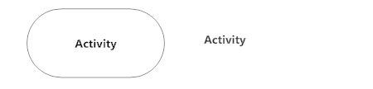
Basic Activity Diagram Notations and Symbols
Activity or Action State
An action state represents the non-interruptible action of objects.
action state can be represented using a rectangle with rounded corners.
18CSC202J - Object Oriented Design and Programming S - 12 & 13 / UNIT - 3

Slide 151

Basic Activity Diagram Notations and Symbols
Action Flow
Action flows, also called edges and paths, illustrate the transitions from one action state to another. They are usually drawn with an arrowed line.
Shows the directional flow, or control flow, of the activity. An incoming arrow starts a step of an activity; once the step is completed, the flow continues with the outgoing arrow.
18CSC202J - Object Oriented Design and Programming S - 12 & 13 / UNIT - 3

Slide 152
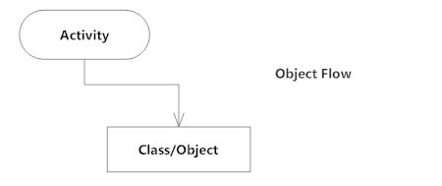
Basic Activity Diagram Notations and Symbols
Object Flow
Object flow refers to the creation and modification of objects by activities.
An object flow arrow from an action to an object means that the action creates or influences the object. An object flow arrow from an object to an action indicates that the action state uses the object.
18CSC202J - Object Oriented Design and Programming S - 12 & 13 / UNIT - 3

Slide 153

Basic Activity Diagram Notations and Symbols
Decisions and Branching
A diamond represents a decision with alternate paths.
When an activity requires a decision prior to moving on to the next activity, add a diamond between the two activities.
The outgoing alternates should be labeled with a condition or guard expression. You can also label one of the paths "else."
18CSC202J - Object Oriented Design and Programming S - 12 & 13 / UNIT - 3

Slide 154
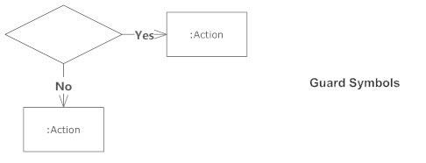
Basic Activity Diagram Notations and Symbols
Guards
In UML, guards are a statement written next to a decision diamond that must be true before moving next to the next activity. These are not essential, but are useful when a specific answer, such as "Yes, three labels are printed," is needed before moving forward.
18CSC202J - Object Oriented Design and Programming S - 12 & 13 / UNIT - 3

Slide 155
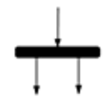
Basic Activity Diagram Notations and Symbols
Fork symbol
Splits a single activity flow into two concurrent activities. Symbolized with multiple arrowed lines from a join
18CSC202J - Object Oriented Design and Programming S - 12 & 13 / UNIT - 3

Slide 156
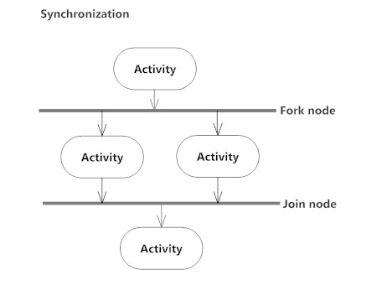
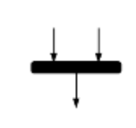
Basic Activity Diagram Notations and Symbols
Joint symbol/ Synchronization bar
A join node joins multiple concurrent flows back into a single outgoing flow.
A fork and join mode used together are often referred to as synchronization.
18CSC202J - Object Oriented Design and Programming S - 12 & 13 / UNIT - 3

Slide 157
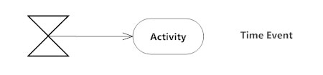
Basic Activity Diagram Notations and Symbols
Time Event
This refers to an event that stops the flow for a time; an hourglass depicts it.
18CSC202J - Object Oriented Design and Programming S - 12 & 13 / UNIT - 3

Slide 158

Basic Activity Diagram Notations and Symbols
Note symbol
Allows the diagram creators or collaborators to communicate additional messages that don't fit within the diagram itself. Leave notes for added clarity and specification.
18CSC202J - Object Oriented Design and Programming S - 12 & 13 / UNIT - 3

Slide 159

Basic Activity Diagram Notations and Symbols
Option loop symbol
Allows the creator to model a repetitive sequence within the option loop symbol.
18CSC202J - Object Oriented Design and Programming S - 12 & 13 / UNIT - 3

Slide 160
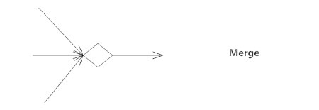
Basic Activity Diagram Notations and Symbols
Merge Event
A merge event brings together multiple flows that are not concurrent.
18CSC202J - Object Oriented Design and Programming S - 12 & 13 / UNIT - 3

Slide 161


Basic Activity Diagram Notations and Symbols
Send signal symbol
Indicates that a signal is being sent to a receiving activity.
Receive signal symbol
Demonstrates the acceptance of an event. After the event is received, the flow that comes from this action is completed.
18CSC202J - Object Oriented Design and Programming S - 12 & 13 / UNIT - 3

Slide 162
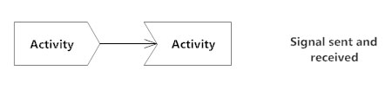
Basic Activity Diagram Notations and Symbols
Sent and Received Signals
Signals represent how activities can be modified from outside the system.
They usually appear in pairs of sent and received signals, because the state can't change until a response is received, much like synchronous messages in a sequence diagram.
For example, an authorization of payment is needed before an order can be completed.
18CSC202J - Object Oriented Design and Programming S - 12 & 13 / UNIT - 3

Slide 163

Basic Activity Diagram Notations and Symbols
Flow final symbol
Represents the end of a specific process flow. This symbol shouldn’t represent the end of all flows in an activity; in that instance, you would use the end symbol. The flow final symbol should be placed at the end of a process in a single activity flow.
18CSC202J - Object Oriented Design and Programming S - 12 & 13 / UNIT - 3

Slide 164

Basic Activity Diagram Notations and Symbols
Final State or End Point
An arrow pointing to a filled circle nested inside another circle represents the final action state
18CSC202J - Object Oriented Design and Programming S - 12 & 13 / UNIT - 3

Slide 165
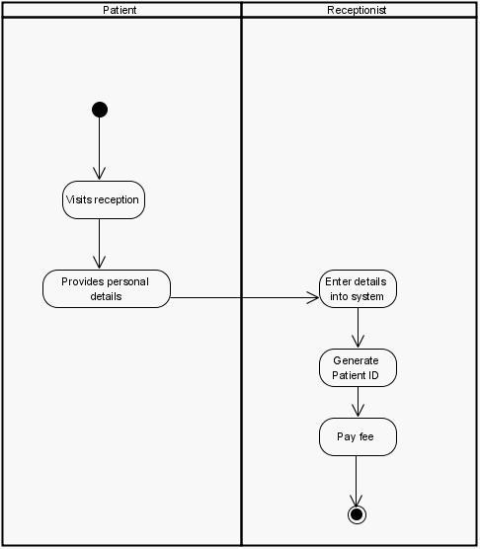
Activity Diagram Registration :-
18CSC202J - Object Oriented Design and Programming S - 12 & 13 / UNIT - 3

Slide 166
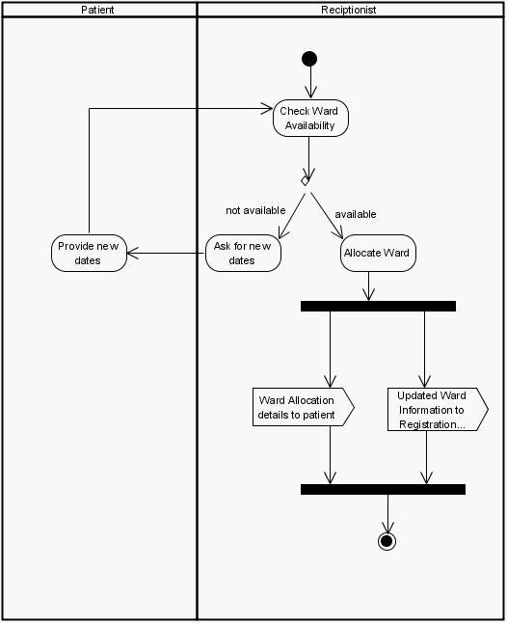
Activity Diagram for Ward Allocation:-
18CSC202J - Object Oriented Design and Programming S - 12 & 13 / UNIT - 3

Slide 167
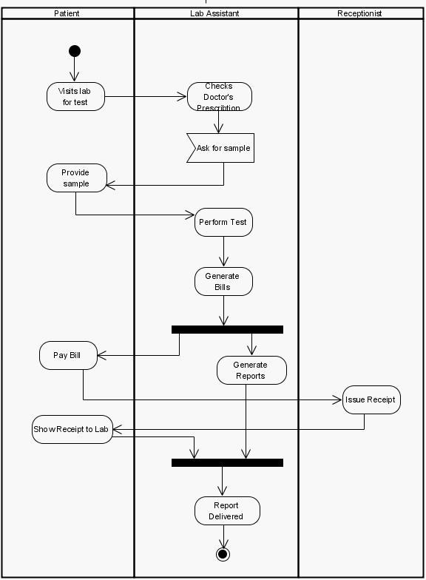
Activity Diagram for Tests to Perform:-
18CSC202J - Object Oriented Design and Programming S - 12 & 13 / UNIT - 3

Slide 168
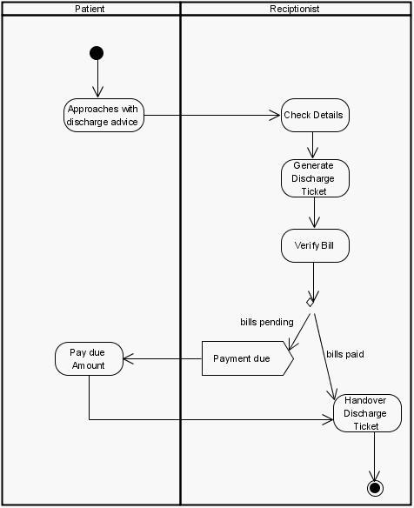
Activity Diagram Discharge:-
18CSC202J - Object Oriented Design and Programming S - 12 & 13 / UNIT - 3

Slide 169
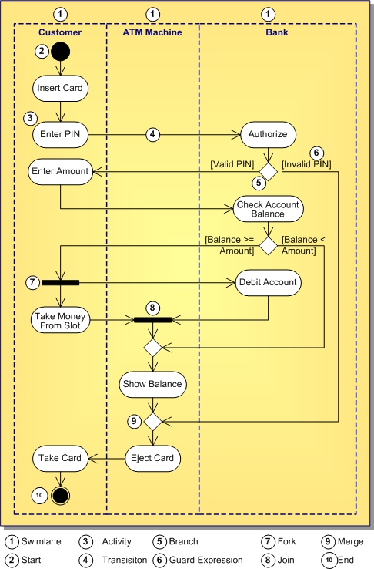
18CSC202J - Object Oriented Design and Programming S - 12 & 13 / UNIT - 3

